Slide 1
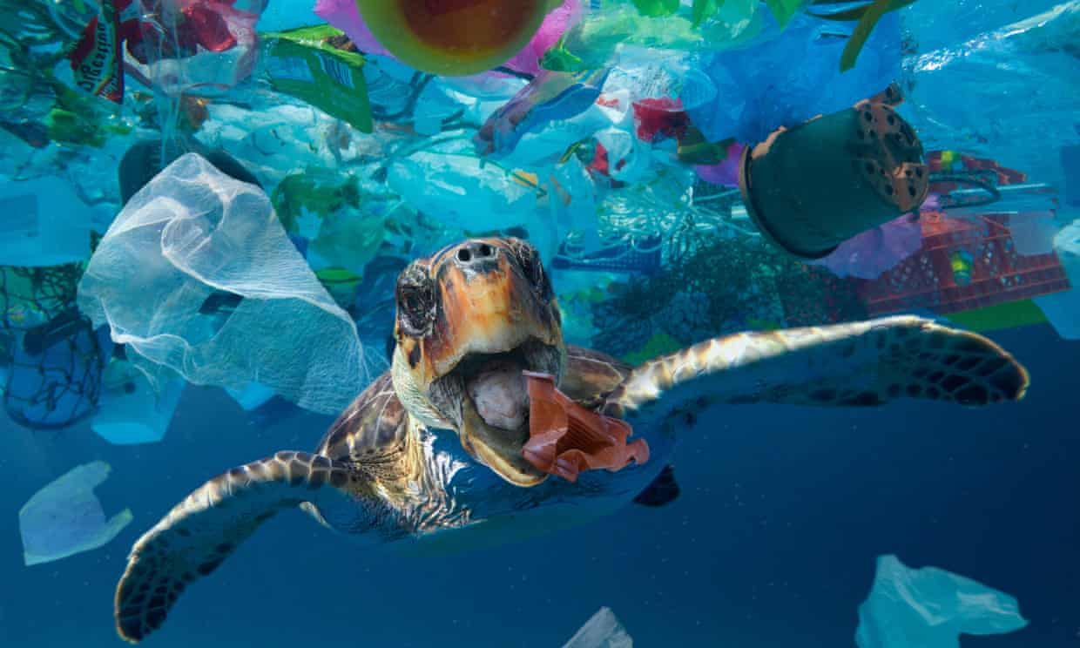
Plastic PullOutCean
A trip surrounded by plastic

Slide 2
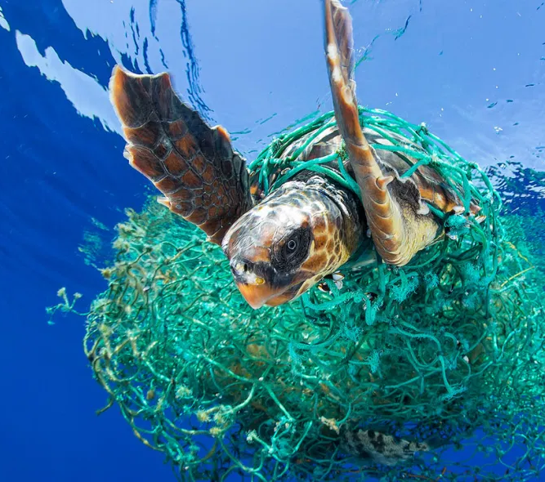
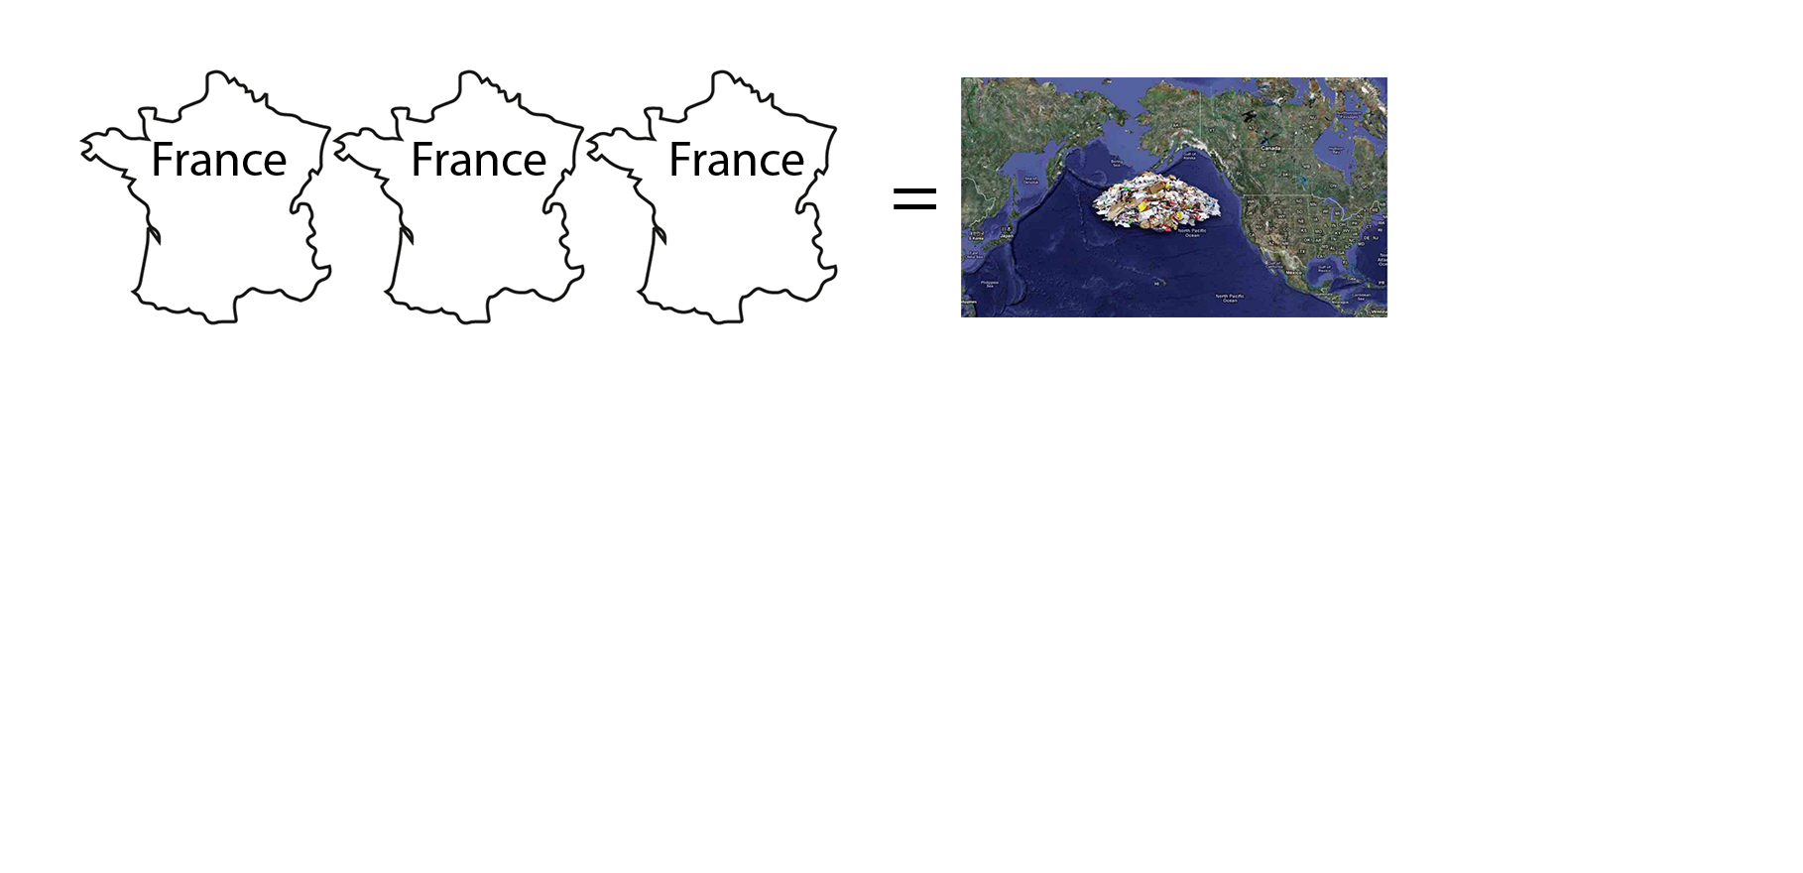
The context
Day by day, plastic is flowing into our natural environment. The end point of this trip is often the Ocean.
The amount of plastic into the ocean increases by a quantity equivalent to 33800 plastic bottles every minute, now it is like 3 times France’s surface.
Every year, ocean pollution kills 100000 animals surrounded by our plastic garbage.
Not so many people care about it. We are all part of the problem, but now it is time to be involved in the solution!

Slide 3
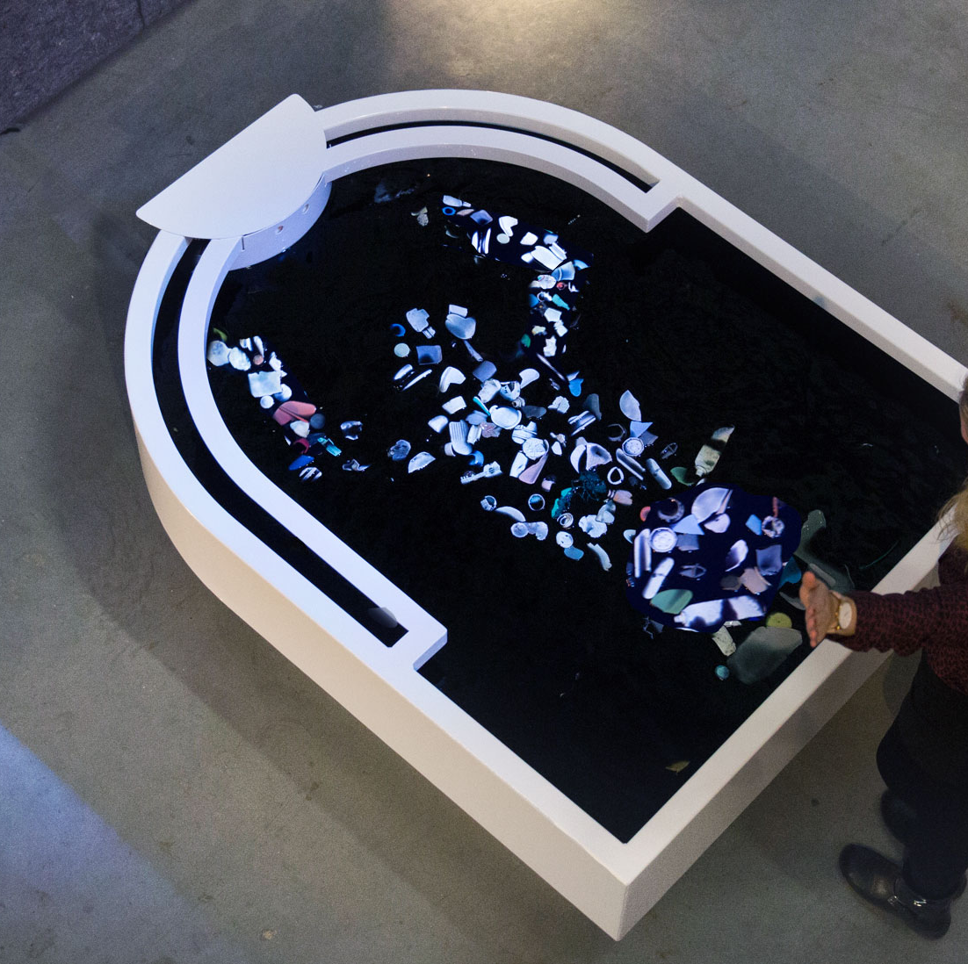
State of the art
Artistic installations
Sculptures in recycled plastic
Educational games online for kids
“Plastic Reflectic”, a plastic reflective- interactive installation by Thijs Biersteker, Plastic soup Foundation
Awareness campaign spots

Slide 4
The idea
Plastic PullOutCean is a project to allow people to really feel how is to suddenly swim into an ocean full of plastic.
In order to rise the awareness around this issue, through a claustrophobic experience surrounded by plastic, without the chance to escape, unless using an ecological behaviour.
The idea is to create an interactive installation, where virtual reality and good action in real world are connected to find a way to clean the real and virtual ocean.

Slide 5
Purpose
Educational
Increase awareness
Try an unique experience

Slide 6
Target
Environmental organization (WWF, Greenpeace ecc… ecc…).
National governments and international organisations.
Aquarium.
Component within the exhibitions.

Slide 7
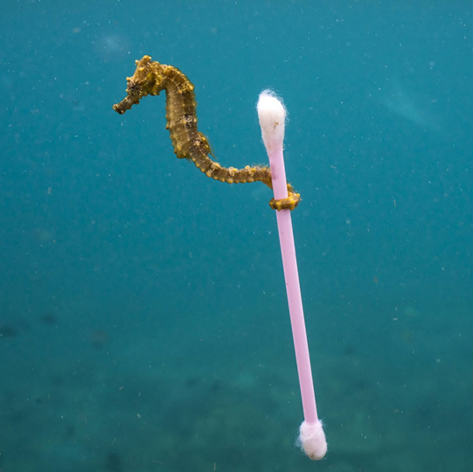
Our team
Ilenia D’Angelo,
Mechanical engineer
Giovanni Di Marco,
Electronics engineer
Riccardo Zuppetti,
Computer engineer

Slide 8
Thanks for the attention

